Slide 2
Innovation ?
Innovation is introduction of new product or services or improvement in existing products or services with distinguishing features .
Continuous innovation
Change in the existing product with marginal changes

Slide 3
Discontinuous innovation
Introducing completing new product in market
Internet , mobile technology
Dynamically continuous
It falls between continuous innovation and discontinuous innovation
Use of electronic type writer, use of digital watches

Slide 4
Technological innovation process or Diffusion of innovation

Slide 5
Innovators
Those who wants to be the first to acquire new product or service
They are risk takes
Price insensitive
Can handle high degree of uncertainty

Slide 6
Early Adopters
They are not very risk takers like innovators
They wait for product or service reviews before buying them
They are also called opinion leaders or influencers as they are regarded as role models in the society
They play key role in spreading innovations

Slide 7
Early Majority
They are not risk taker
They buy product only after product is tried and tested by the trusted peers

Slide 8
Late Majority
These are conservative people
Very cost sensitive
Generally they are peer pressured into purchasing product or service

Slide 9
Laggards
They are the last adopter of the new product or service
They do not like to change
They adopt innovation unless it is compulsory to do so.

Slide 10
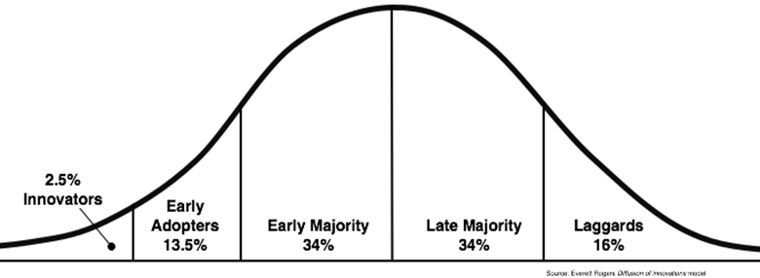

Slide 11
Commercialization of innovation through alliances or Strategic alliances

Slide 12
Strategic alliances
Strategic alliances in business is relationship between two or more businesses to achieve certain common objectives which would not have been possible had they gone alone.

Slide 13
Advantages
Companies will cooperate with each other instead of competing
Companies can create competitive advantage together by sharing resources and skills
Companies can learn new skills from strategic partners
Strategic partner can help each other to increase productivity
Companies can reduce cost and risk and it will be distributed between them
Companies can get entry into foreign market through alliance

Slide 14
Joint Venture
It is business entity created by two or more companies
They share the ownership
They share the risk
They share the governance
Examples: Tata Starbucks Limited

Slide 15
Equity strategic alliance
An equity strategic alliance occurs when one company purchases equity in another business
Telsa purchased equity in Panasonic for battery manufacturing

Slide 16
Non equity strategic alliances
When organisations create agreement to share renounces without buying equity
Uber and spotify to enhance travel experience of customers

Slide 17
Situation Analysis ( 5 Cs)
Process of understand the internal capabilities of companies by analysing internal, external environment

Slide 18
Company Analysis
What are goal and objectives of the company
What are marketing strategies
Sells what Product
Sells product at what price
How does company distribute product
How does company Promote product
What is competitive advantage of the company
How product are different from competitors

Slide 19
Customer Analysis
What are needs wants and demands of the customs
What is income level of customers
What product does customer buys
When does customer buy product
Where does customer buy product
How frequently does customer buy product
How much quantity does customer buy
Why does customer buy ?

Slide 20
Competitors Analysis
Who are your direct, emerging, and established competitors?
What other products do your competitors offer that you don’t?
What are biggest strengths of your competitors
What are biggest weaknesses of your competitors
What is competitive advantage of your competitors
What is USP of competitors
What are marketing strategies of competitors
What is market segment of the competitors
What are 4Ps of competitors

Slide 21
Collaborator Analysis ( People with whom you partner for running business)
Who are investors in your business
Who manages your adverting and marketing campaign
Who are your suppliers
Who are your transporters
Who manage your warehousing operations
Who are your distributors
Which bank manages your current account
Which e commerce platform do you use

Slide 22
Climate Analysis ( PEST Analysis )
How is political environment of the country and how is business environment of the county
How is the Economic environment of the country ( GDP growth rate, Interest rate, inflation rate, unemployment rate)
How is social environment of the country (Demographic factors like Age distribution, Income distribution, Education level, Population growth rate, cultures barriers etc)
How is technological environment of country ( Technological awareness of the market, incentives give by govt on new technologies, Automations, R& D activities )

Slide 23
Return on Marketing Investment
A law firm that focuses on housing-related cases, wants to gain more clients. They write five blog posts about tenant rights. Each post includes a tracking URL that links to a landing page where prospects can request a free legal consultation.
The firm spent $900 paying employees to draft five blog posts and $100 to promote it. The posts result in eight leads -- four of which become clients. The firm made an average of $2,000 per client.

Slide 24
Return on Marketing Investment
[((number of leads x lead-to-customer rate x average sales price) - cost of ad spend) ÷ cost of ad spend] x 100
No. of leads= how many people converted to lead
Lead to customer rate= what percentage of leads became customers
Avg. Sales price= Avg. Price of product
Cost of ad spent= Amount spent on marketing campaign

Slide 25
Example 2
A local dog daycare offers a weekly e-newsletter to customers and those who sign up on their website. An organic dog food company pays them $100 to place an ad that links to a purchasing page for their newest product.
Because the ad is linked with a tracking URL, the dog food company can see that it drove number of visitors to their product page. Of those visitors, 20 placed the dog food in their cart and 17 purchased it at $20

Slide 26
Example 3
The team decides to make a demo video to show sales reps how the software works and how it can help them cut down on time-consuming tasks. The video is shared on LinkedIn along with a tracking link to the demo signup landing page. The video is also placed on the landing page itself.
It cost the company $300 to buy video supplies and $200 in labour to produce the video. After it was circulated, it resulted in five demo signups which lead to three purchases of the $2,000 product.

Slide 27
Example 4
A boutique wants to promote their new line of summer dresses, but they don't have time or equipment to make a video. They connect with a local fashion influencer and pay her $300 to do an Instagram video titled, "The Best Summer Dresses for 2019."
They tell the influencer to place a tracking URL to the online store in her bio. She also directs viewers to the bio in the video's caption. Through the tracking link, the boutique can see that they've gotten 50 visits. Of those visits, 30 people put an item in their cart. Ten purchased one of the $50 dresses.

Slide 28



Example 5
An online gardening store wants to use a PPC ad to spread awareness of a new line of luxury lawn mowers -- which cost $1,000 each.
On their first campaign, where the price isn't shown, they spent $1,000. Of the visitors they received, three placed the item in their cart and one made a purchase. In the next campaign, they included the price. They spent a total of $500. Of their web visitors, 12 placed the lawnmower in a cart and seven purchased it.
To see how the PPC ad's script change impacted ROI, the garden store could use the formula for both campaigns. They could count users who carted the product as a lead.

Slide 29


Example 6
lifestyle publication is trying to gain web subscriptions, which cost $10 a month. They decide to offer a one-month free trial to pull in leads. They create a post about the trial for Twitter which includes a tracking URL that leads to the free-trial landing page.
They boost the post for four days with a budget of $25 per day. In the timespan of the posted boost, they'd received 100 visitors and 20 signed up for a free trial. Of the 20, four become paid subscribers.

Slide 30
Market share calculations
A beverage company that has recently launched a new line of non-alcoholic beers. Last year the company booked total sales of $50 million. Calculate the market share of the company if the total market size of the non-alcoholic beverage industry is $500 million

Slide 31
Market Share = (Total Sales of the Company / Total Sales of the Market) * 100

Slide 32
Example 2
Four companies – company A, company B, company C, company D, that form the entire industry. During FY18, company A, company B, company C, and company D clocked total sales of $55 million, $75 million, $35 million and $45 million respectively. calculate the market share of company B based on the available information.

Slide 33


Example 3
During Q4 2018, Apple and Samsung sold 64.5 million units and 70.8 million units respectively. According to sources, the total volume of mobile phone sales of the entire global market during the same period stood at 408.2 million units. Calculate the market share of Apple and Samsung based on the number of units sold

Slide 34
Pay back period
A particular Marketing Project Cost USD 10 Lakh, and the profitability of the project would be USD 2.5 Lakhs per year. Calculate the Payback Period in years.

Slide 35
Pay Back Period
Pay back period = Initial investment/ cash flow

Slide 36
Example 2 ( Uneven cash flows)
A Company is considering investment of 600000 on marketing project
Cash flow for the same will be 120000,140000,180000,200000,250000.
Calculate pay back period

Slide 37



Year | Cash Flow | Cumulative cash flow
0 | -600000 | -600000
1 | 120000 | -480000
2 | 140000 | -340000
3 | 180000 | -160000
4 | 200000 | 40000
5 | 250000
3 years + 160000/20000
3 years and 8 months

Slide 38
Example 3 ( Uneven cash flows)
A Company is considering investment of 500000 on marketing project
Cash flow for the same will be 170000,170000,120000,120000,120000.
What would be pay back period

Slide 39
Year | Cash Flow | Cumulative cash flow
0 | -500000 | -500000
1 | 170000 | -330000
2 | 170000 | -160000
3 | 120000 | -40000
4 | 120000 | 80000
5 | 120000

Slide 40
Example 4 ( Uneven cash flows)
A Company is considering investment of 20000 on marketing project
Cash flow for the same will be,7500,6500,5500,7500

Slide 41
Inventory turnover
Inventory turnover measures how often a company replaces inventory relative to its cost of sales. Generally, the higher the ratio, the better.
When Inventory Turnover Ratio is High – The company has been managing its inventory quite well, with lesser holding costs
When Inventory Turnover Ratio is Low – If a company’s inventory turnover is very low, its products are often not sold in the market. As a result, the company’s inventory becomes a slow-moving inventory, which leads to higher inventory costs and fewer profits.

Slide 42
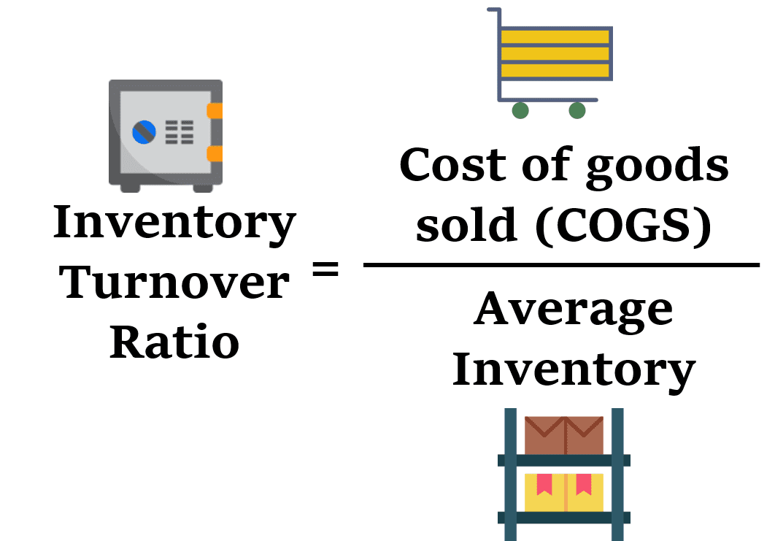

Slide 43


Example 1
Cool Gang Inc. has the following information:–
Cost of goods sold – $600,000
The beginning inventory – $110,000
The ending inventory – $130,000
Find inventory turnover ratio

Slide 44
Example 2
Cost of goods sold | 4,50,000
Inventory at the beginning | 1,25,000
Inventory at the end | 1,75,000

Slide 45
All Commodity Volume ( ACV)
ACV measures ability of the outlet to distribute a brand to the customers
ACV gives idea traffic of the store
ACV % = Total sales of the store carrying your brand / Total sales of all store x 100

Slide 46
Outlets | Total Sales Rs. | Sales of Shampoo | Your brand of shampoo
Store 1 | 1,00,000 | 1000 | Available
Store 2 | 75,000 | 500 | Available
Store 3 | 50,000 | 300 | Available
Store 4 | 40,000 | 400 | ------

Slide 47
ACV % = ( 1,00,000+ 75,000+50,000/1,00,000+ 75,000+50,000+ 40,000) x 100
ACV% = 84.90 %
Higher ACV indicates that there is high traffic in the store were your products are available

Slide 48
Same store sales growth
Same store sales is a business term used to evaluate performance to the store where company products are sold for one year

Slide 49
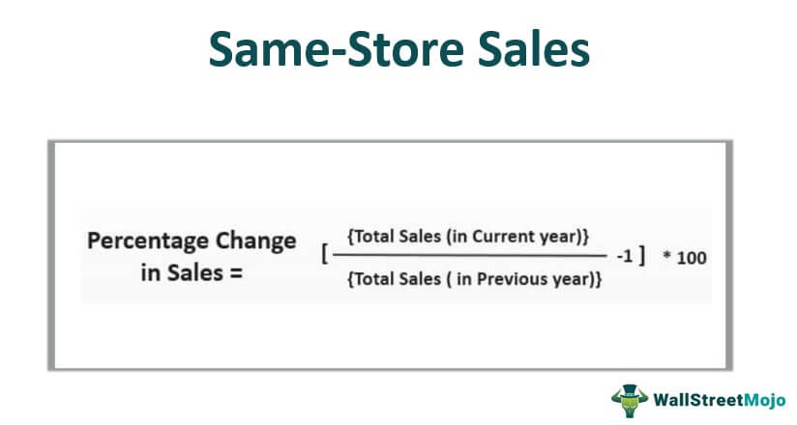


Slide 50

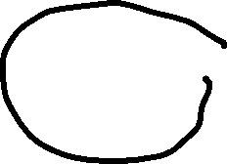



Example 1

Slide 51
In 2020, the 100 stores generated sales of $100,000. In 2021, each store generated sales of $1,000. Using the same number of stores in 2020, the total sales amount to $110,000 in 2021 for the same stores. Therefore, same-store sales are calculated as:
Same-store sales = ($110,000 / $100,000 – 1) x 100 = 10%
Positive same store sales indicate increase in number of customers

Slide 52


Example 2
Peter's Pizza Company wants to determine its same-store sales after increasing its number of locations throughout the country. In 2019, the company generated $200,000 at its 100 locations across the country, meaning each store reported $2,000 in sales. However, the company added 25 locations and reported $400,000 in sales,
Same store sales ?

Slide 53
Net Promoter Score
Net promoter score measures customer experience
It is used to measure customer loyalty and satisfaction
It is used to check how likely customer is going to recommend your brand name on the scale of 0 to 10 to other people

Slide 54
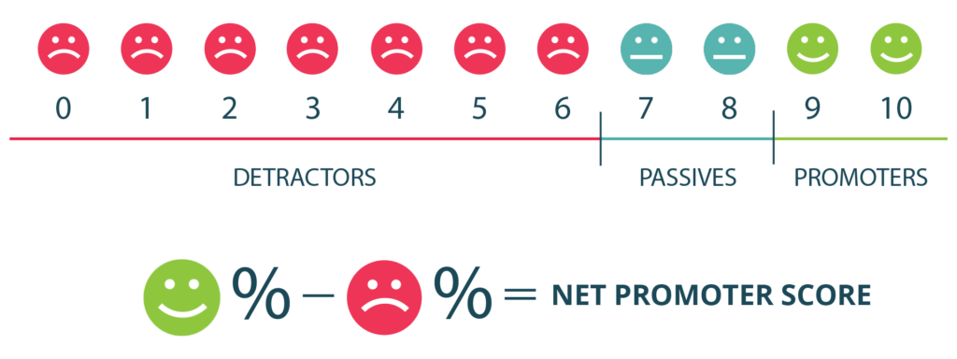

Slide 55
Detractors
Detractors : They are unsatisfied customers
They will never recommend your products to any one
They will say bad things about your product
They will never come back to buy your product
Rating from 0 to 6

Slide 56
Passives
They are neutral customers
They do not speak good or bad things about your product
Rating 7 to 8

Slide 57
Promoters
These are satisfied customers
They are loyal customers which keep buying product from you
They will actively promote your product
Rating 9 to 10

Slide 58
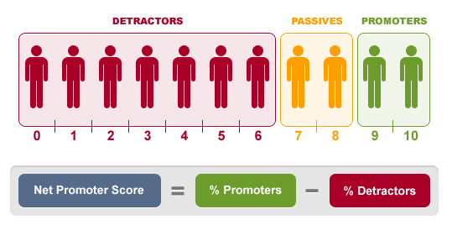
Formula

Slide 59

Suppose there are 500 customer
350 customers have rated 9 and 10
50 customers have rated 7 and 8
100 customers have rate 0 to 6
Promoter % = 350/500 x 100 = 70%
Detractor % =100/500 x 100= 20%
Net promoter score : 70 % - 20% = 50 %
It should be always more than 30 %

Slide 60
Benchmarking
A score between 0 and 30 is a good range to be in, however, there is still room for progress.
If your NPS is higher than 30 that would indicate that your company is doing great and has far more happy customers than unhappy ones.
An NPS over 70 means your customers love you and your company is generating a lot of positive word-of-mouth from their referrals.
https://npscalculator.com/en

Slide 61
Share of wallet
share of wallet is the amount an existing customer spends regularly on a particular brand rather than buying from competing brands.

Slide 62
 | Customer
Company1 ( X Product) | 40
Company 2( Y product) | 30
Company 3( Z product) | 30
 | 100

Slide 63
Market cannibalization
Cannibalization is a reduction in sales of one product when the same company introduces a new product

Slide 64
Cannibalism Rate
Cannibalism Rate = No. of sales lost on existing product ÷ Sales of new product x 100
Last year sales of product A was 4000 units which is reduced to 3000 unit because launch of new product by the company. Sales of new product for current year 3000 units. Find out cannibalism rate
1000/ 3000* 100= 33.33%

Slide 65
Omni channel Marketing
Use of all available media channels by integrating it with each and customers are retargeted by sending them personalized messages
Website
Twitter
Facebook
Youtube

